Slide 1

Helping You
Help your community
After a disaster

Slide 2
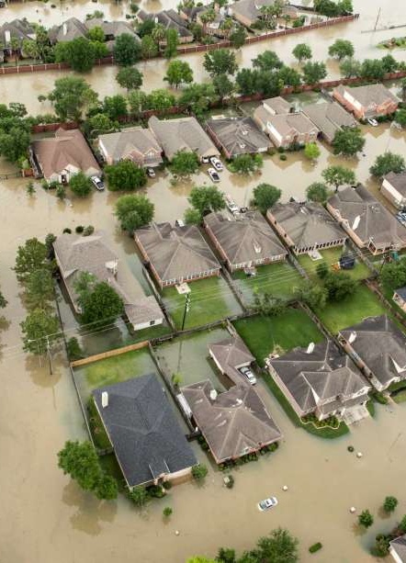
Problem: Disaster Relief
Difficult
Only so much gov’t and non-profits can do
You want to help, but how?
Barrier for individuals to help is too big
San Jose Flood? Hurricane Harvey?

Slide 3
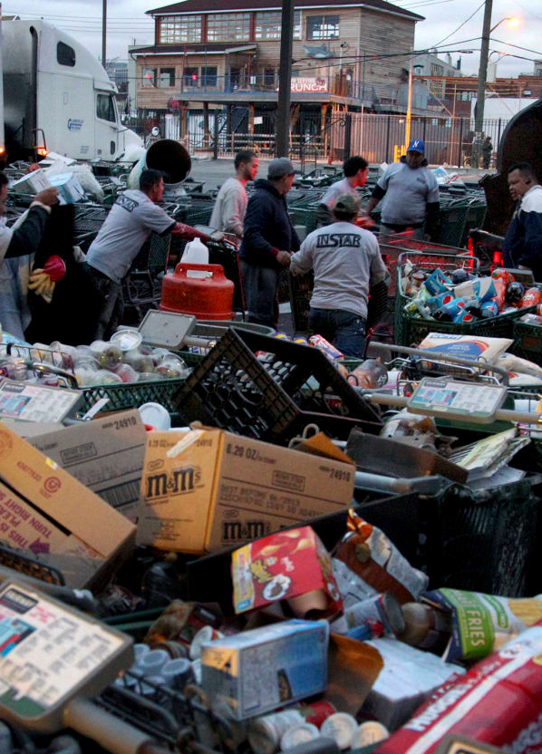
Community Cache
Partner with the community
Local Businesses, Governments, NPOs
Our best allies: People you know
I need help
I can help
Donation tracking
Tax write offs
Corporate responsibility
Good citizen reimbursements

Slide 4
DEMO

Slide 5
THANK YOU Questions?
Kristian Tally, John Kang, Stephen Han, Julian Threatt, Michael Fuery

